Slide 1
NIEM 3.0

Slide 2
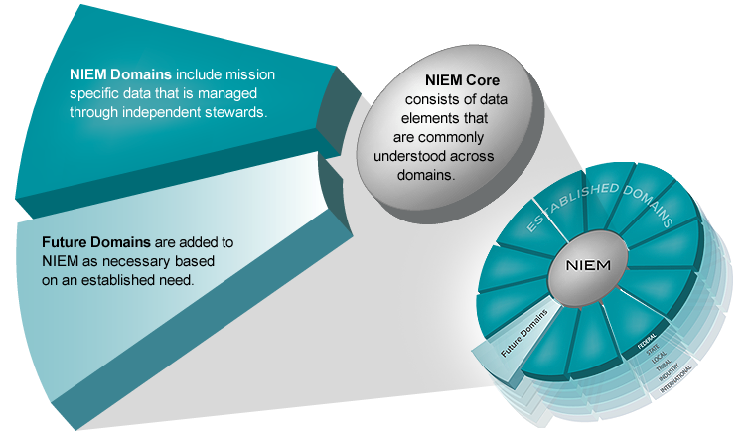
Major vs. Minor Release
NIEM 3.0 is a major release of the NIEM data model—containing updates to the NIEM Core as well as changes to several Domains.
A minor release involves limited changes to Domains

Slide 3
How has NIEM evolved over the years?
MAJOR
NIEM 1.0
MAJOR
NIEM 2.0
MINOR
NIEM 2.1
MAJOR
NIEM 3.0
1.0 Core
2.0 Core
2.0 Core
3.0 Core
1.0 Domains
2.0 Domains
2.1 Domains
3.0 Domains
2006
2007
2009
2013
Reference Schemas

Slide 4
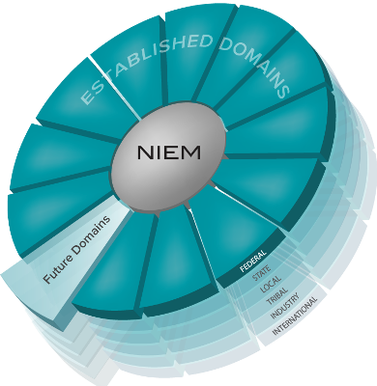
NIEM 3.0 Inputs
Domain Content Updates & Additions
Architectural Improvements
Content Harmonization
Resolved NIEM Configuration Control Tool (NCCT) Issues
Content Related NCCT Issues

Slide 5
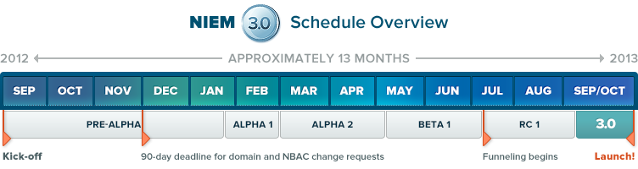
NIEM 3.0 Release cycle
Pre-alpha is the requirements gathering phase when all significant content changes are identified. During this phase:
Domains prepare change requests for new and changed content.
Domains indicate domain updates to be integrated.
Alpha 1 and Alpha 2 are the first two rounds of review where inputs and feedback regarding changes/requirements are collected and organized into coherent lists. These lists are then made ready for Governance review. Alpha 2 was the first opportunity for public review.
Beta continues the feedback process and is the last opportunity to provide public feedback on the full model. Like Alpha 1 and 2, inputs from Beta are reviewed by the Governance body.
In the Release Candidate (RC) phase, final adjustments, refinements, and corrections are made before Governance body review.
After
Governance
Body
approval, the model is Finalized & Published

Slide 6
NIEM 3.0 Content Updates (changes from 2.1)
Domains
New Domain: Biometrics
Updates: Justice, CBRN, Immigration, Screening, Biometrics, International Trade, Maritime
Family Services (FS) changed its name to Children, Youth, & Family Services (CYFS)
Resolved issues in NIEM Configuration Control Tool (NCCT)
100+ NCCT issues backlogged after NIEM 2.0 and 2.1
~100 issues resolved since the NIEM 3.0 Kickoff in August
Significant object updates: LocationType (refactored), DocumentType, ContactInformation (types and associations), FacilityType, ItemType, BiometricType, Measures and MeasureType.
New code lists: HL7 (religion), GENC, Census-USCounty, occs-facility, DoL-soc (occupations), XCard (v-card XML representation)
Code list updates: FIPS (sunset lists), mmucc, nga-vdatum, ansi-d20
Harmonization: Justice & Biometrics, Immigration & Screening, CBRN & International Trade, Screening & Biometrics, Core & Biometrics

Slide 7
NIEM 3.0 Technical Updates: Simplified structures
NIEM 2.0 | NIEM 3.0
structures:linkMetadata attribute | Replaced with structures:relationshipMetadata attribute
structures:sequenceID | Removed
structures:Augmentation element | Removed
structures:Metadata element | Removed
structures:ComplexObjectType | Replaced with structures:ObjectType and structures:AssociationType
structures Object and Association resources (for appinfo:Base) | Removed; extend from base types
structures:ReferenceType | Removed

Slide 8
NIEM 3.0 Technical Updates: Simplified annotations
NIEM 2.0 | NIEM 3.0
appinfo:ConformantIndicator | Schema: use attribute ct:conformanceTargets. Imports: use attribute appinfo:externalImportIndicator
appinfo:Base | Use the base types structures:ObjectType, structures:AssociationType.
appinfo:ReferenceTarget | Use the element's type attribute.
appinfo:AppliesTo | Augmentations: use the augmentation element's substitutionGroup attribute. Metadata: use attributes appinfo:appliesToTypes, appinfo:appliesToElements.
appinfo:ExternalAdapterTypeIndicator | Use attribute appinfo:externalAdapterTypeIndicator

Slide 9
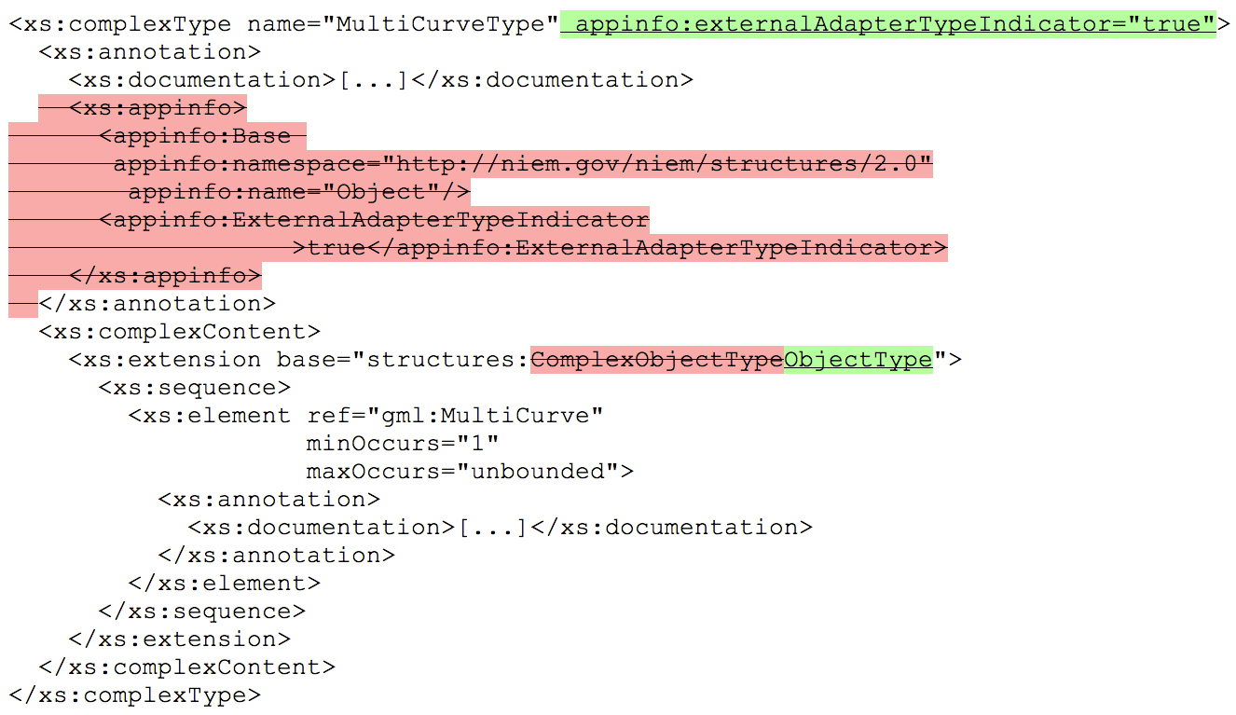
Simplified annotations

Slide 10

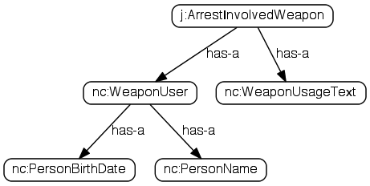
Unified content & reference elements
<j:ArrestInvolvedWeapon>
<nc:WeaponUser>
<nc:PersonBirthDate>
<nc:Date>1968-05-14</nc:Date>
</nc:PersonBirthDate>
<nc:PersonName>
<nc:PersonFullName>Mark Moe</nc:PersonFullName>
</nc:PersonName>
</nc:WeaponUser>
<nc:WeaponUsageText>Fired</nc:WeaponUsageText>
</j:ArrestInvolvedWeapon>
CONTENT
<j:ArrestInvolvedWeapon>
<nc:WeaponUser structures:ref="Person1"/>
<nc:WeaponUsageText>Fired</nc:WeaponUsageText>
</j:ArrestInvolvedWeapon>
<nc:Person structures:id="Person1">
<nc:PersonBirthDate>
<nc:Date>1968-05-14</nc:Date>
<nc:PersonName>
<nc:PersonFullName>Mark Moe</nc:PersonFullName>
</nc:PersonName>
</nc:PersonBirthDate>
</nc:Person>
REFERENCE

Slide 11
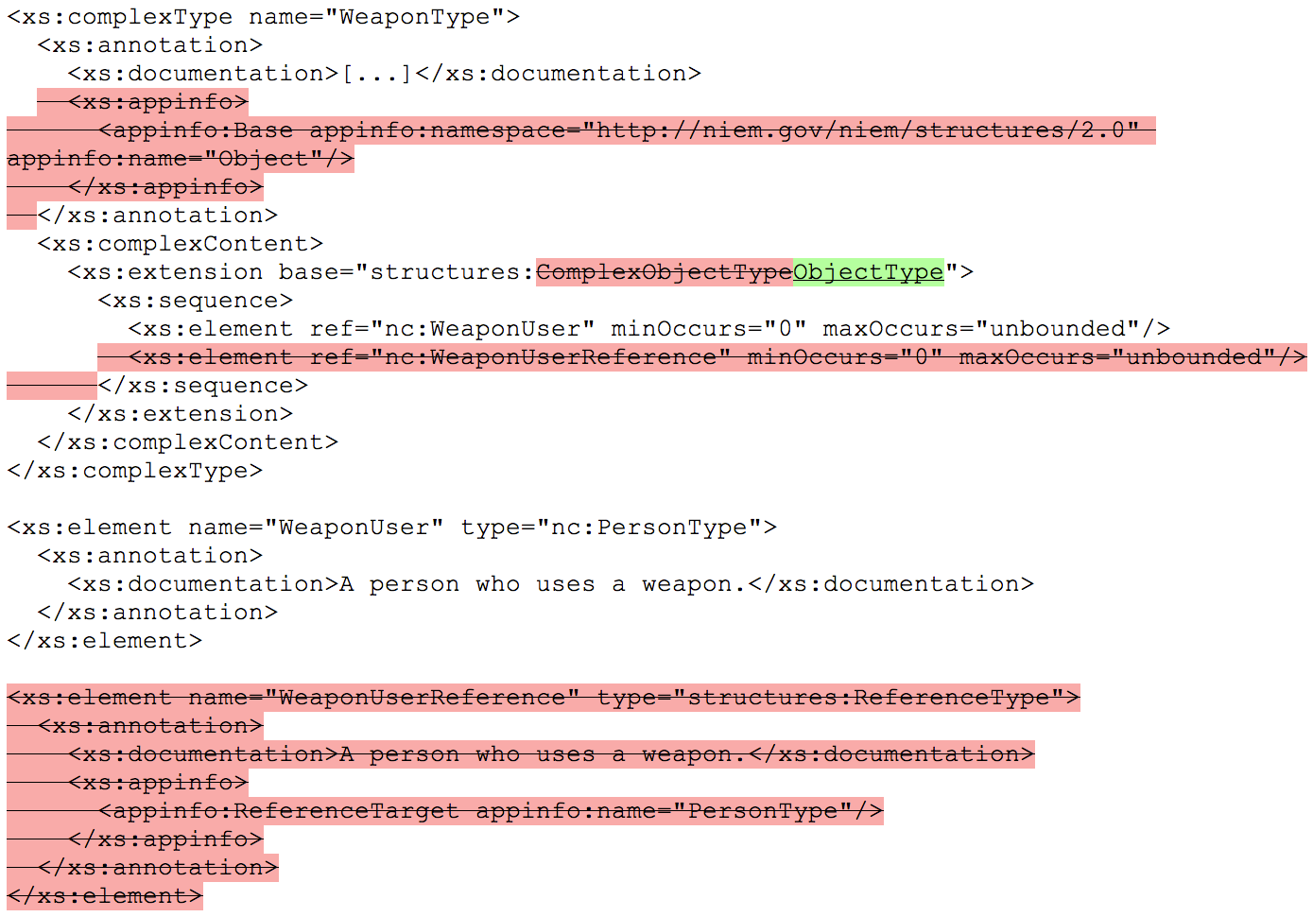
NIEM 3.0 Technical Updates: simplified schemas

Slide 12
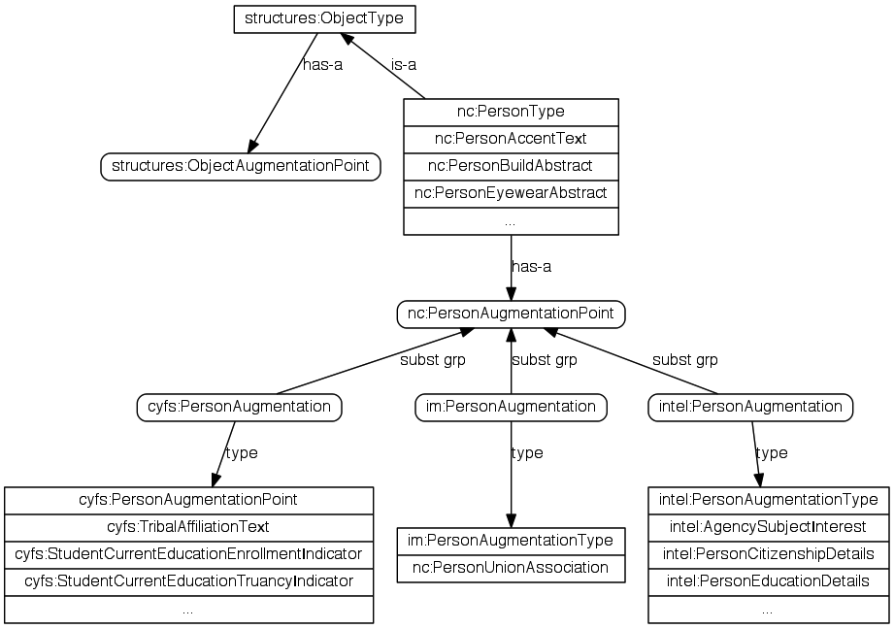
NIEM 3.0 Technical Updates: Updated Augmentations
Augmentations are extensions without subclasses
Each object or association type contains an augmentation point element
Augmentation elements are substitutable for the augmentation point

Slide 13
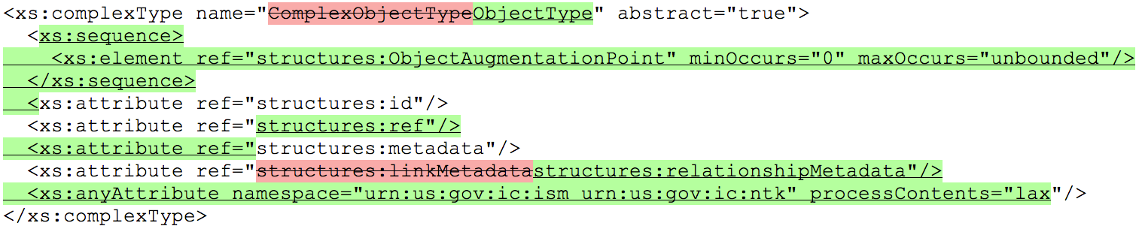
NIEM 3.0 Technical Updates: structures base types
Split ComplexObjectType into ObjectType, AssociationType
Added augmentation point element
Added structures:ref attribute
Renamed linkMetadata to relationshipMetadata
Added attribute wildcard for IC ISM, NTK namespaces

Slide 14
NIEM 3.0 Technical Updates: Local vocabulary
Annotations in the schema identify non-dictionary terminology: jargon, acronyms, slang
Removes NDR 1.3 Table 9-1: Abbreviations
Used in Immigration namespace
<term:LocalTerm term="SEVIS"
literal="Student and Exchange Visitor Information
System"/>
<term:LocalTerm term="ICE"
literal="Immigration and Customs Enforcement"/>
<term:LocalTerm term="USCIS"
literal="United States Citizenship and Immigration
Services"/>
ICEEmployeeType
ICEOfficerType
SEVISPersonDependentAssociationType
ICEEmployee
ICEEmployeeAssistantUSAttorneyIndicator
ICEEmployeeAttorneyIndicator
ICEEmployeeAugmentationPoint
ICEEmployeeBadgeIdentification
ICEEmployeeK9Indicator
ICEEmployeePINIdentification
ICEEmployeePayGradeNumeric
ICEEmployeeTitleText

Slide 15
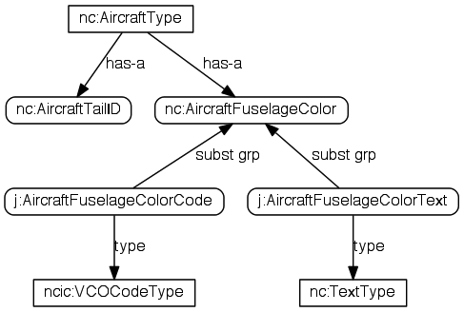
NIEM 3.0 Technical Updates: abstract elements for codes
Code + Text with the same basic meaning
Release defines an abstract, typeless element for each
Code + Text are substituted for the base element

Slide 16
NIEM 3.0 Normative Specifications
NIEM 3.0 was successfully launched on November 6, 2013. Various specifications serve as the “backbone” of the NIEM 3.0 technical architecture.
NIEM Naming and Design Rules V3.0
http://reference.niem.gov/niem/specification/naming-and-design-rules/3.0/
NIEM Model Pacakge Description Specification V3.0
http://reference.niem.gov/niem/specification/model-package-description/3.0/
NIEM Conformance Specification V3.0
http://reference.niem.gov/niem/specification/conformance/3.0/
NIEM Conformant Target Attribute Specification V3.0
http://reference.niem.gov/niem/specification/conformance-targets-attribute/3.0/

